Slide 1


Departamento de Física
PET – Física
Universidade Federal do
Rio Grande do Norte
Introduction to Machine Learning
Theory, Algorithms and Implementation with Python
Gabriel Wendell Celestino Rocha*
*gabrielwendell@fisica.ufrn.br

Slide 2
What is Machine Learning?
Machine Learning is a field of study that focuses on algorithms which help a computer learn from data without explicit programming.
1.

Slide 3
AI vs ML vs DL vs DS
Artificial Intelligence
Artificial intelligence is a field where the goal is to enable computers and machines to perfom human-like tasks and simulate human behavior
Machine Learning
Machine Learning is a subset of AI that tries to solve a specific problem and make predictions using data.
Data Science
Data Science is a field that attempts to find patterns and draw insights from data (might use ML)
Deep Learning
Deep Learning is a subset of ML in which multilayered neural networks learn from vast amounts of data
2.

Slide 4



Types of Machine Learning
01
LIZARD
Supervised Learning - uses labeled inputs (meaning the input has a corresponding output label) to train models and learn outputs
CAT
DOG
3.

Slide 5






Types of Machine Learning
01
Supervised Learning - uses labeled inputs (meaning the input has a corresponding output label) to train models and learn outputs
02
Unsupervised Learning - uses unlabeled data to learn about patterns in data
4.

Slide 6




Types of Machine Learning
01
Supervised Learning - uses labeled inputs (meaning the input has a corresponding output label) to train models and learn outputs
02
Unsupervised Learning - uses unlabeled data to learn about patterns in data
03
Reinforcement Learning - agent learning in interactive environment based on rewards and penalties
5.

Slide 7
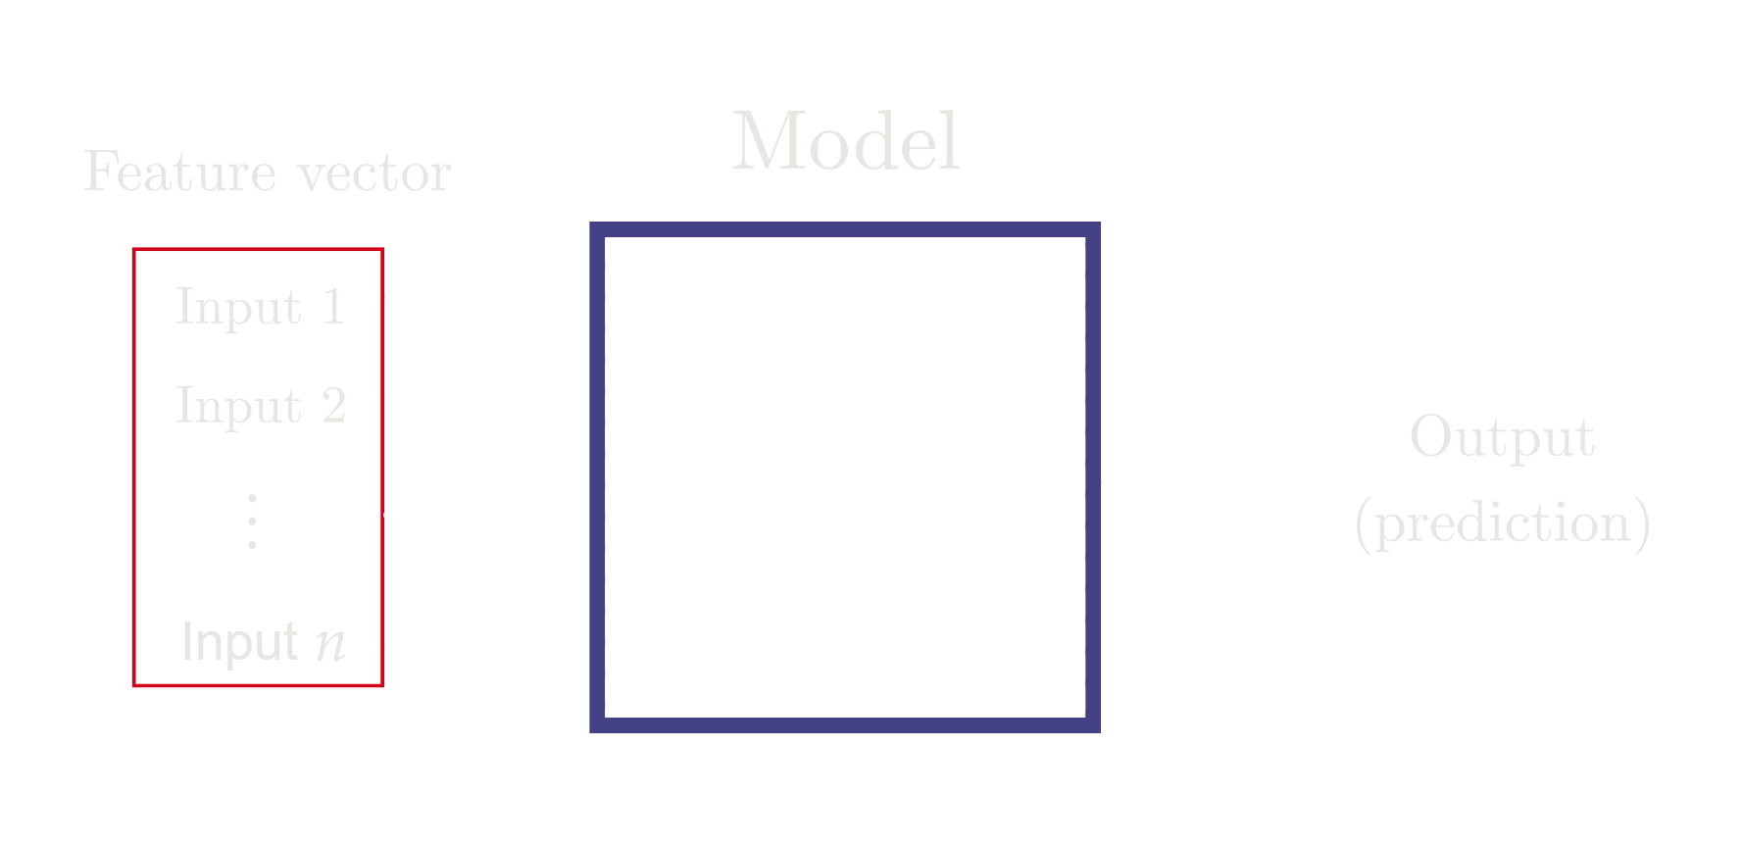
Machine Learning
6.

Slide 8
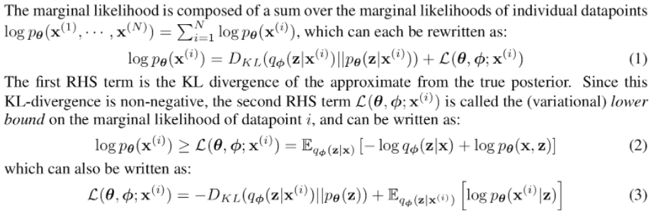
Machine Learning
But what is the language of Machine Learning?
C++
C#
Python
R
Julia
Javascript
Swift
Answer: Statistics!
Kingma & Welling, "Auto-Encoding Variational Bayes", arxiv: 1312.6114
7.

Slide 9
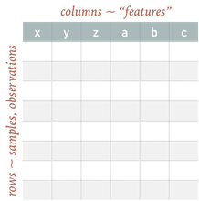
Samples & Features
Qualitative - categorical data (finite number or categories or groups)
Quantitative - numerical valued data (could be discrete or continuous)
8.

Slide 10
Ask Yourself
Are my features categorical/discrete/continuous? Is the order of my samples meaningful?
Are my samples statistically independent? Are they drawn from the same distribution?
What are my measurement uncertainties?
Is my data binned/unbinded?
Is there a natural measure of similarity/distance in my samples (rows)?
9.

Slide 11
Supervised Learning Tasks
01
Classification - predict discrete classes
Binary classification
Multiclass classification
Positive | Negative
Cat | Dog
Spam | Not Spam
Cat | Dog | Lizard | Dolphin
Orange | Apple | Pear
Plant species
10.

Slide 12
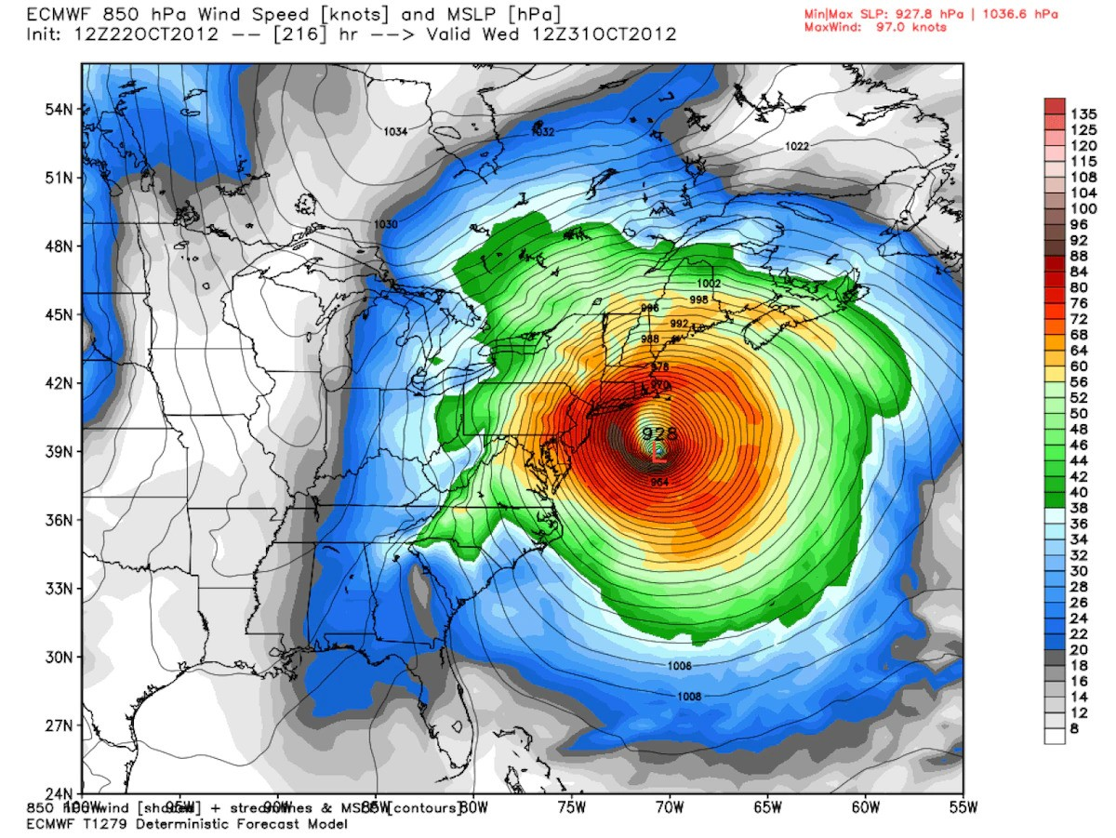
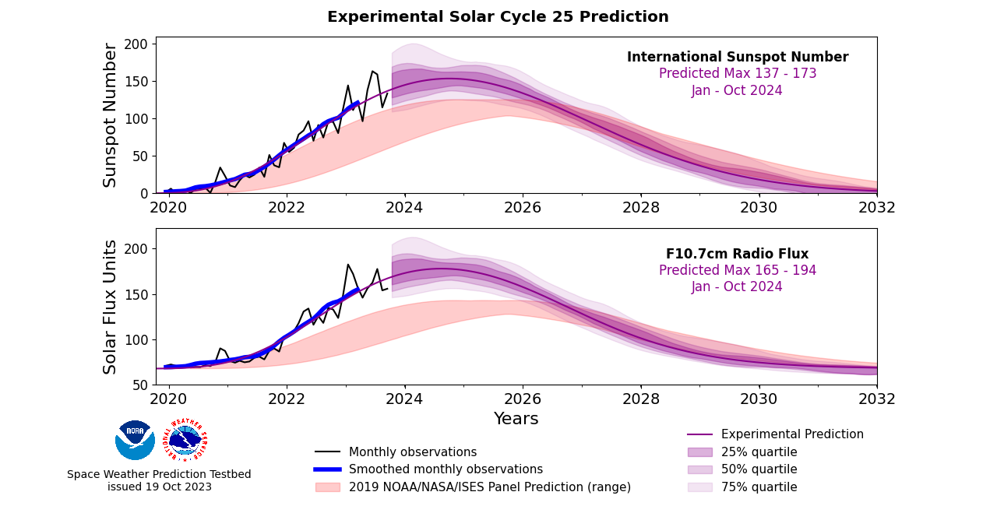

Supervised Learning Tasks
01
Classification - predict discrete classes
02
Regression - predict continuoues values
11.

Slide 13
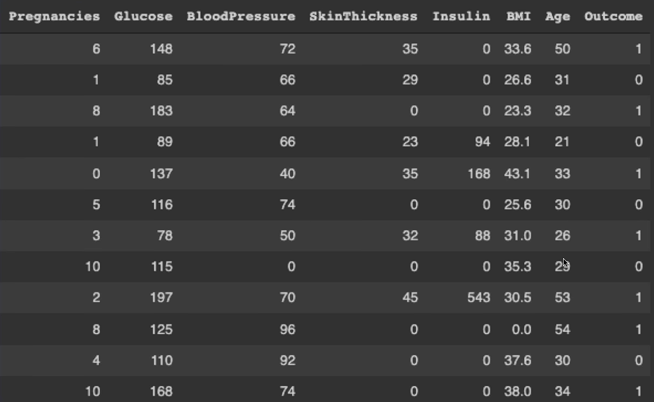
Supervised Learning Dataset
Each row = different sample in the data
12.

Slide 14
Supervised Learning Dataset
Each column = different feature
13.

Slide 15
Supervised Learning Dataset
Except this one, it's the output label!
14.

Slide 16
Supervised Learning Dataset
This is what we would call a feature vector!
15.

Slide 17
Supervised Learning Dataset
Target for that feature vector
16.

Slide 18
Supervised Learning Dataset
Features matrix, X
17.

Slide 19
Supervised Learning Dataset
Labels (targets) vector, y
18.

Slide 20
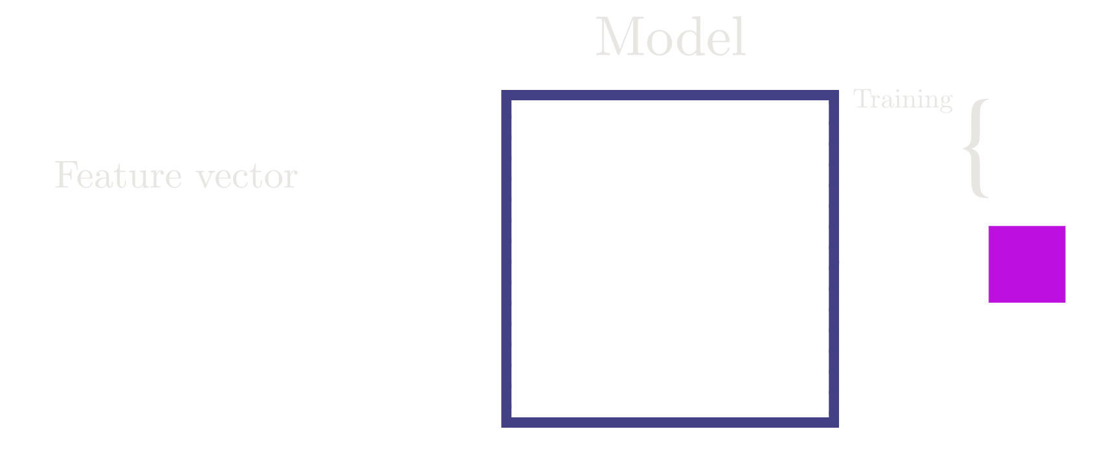
Supervised Learning Dataset
19.

Slide 21
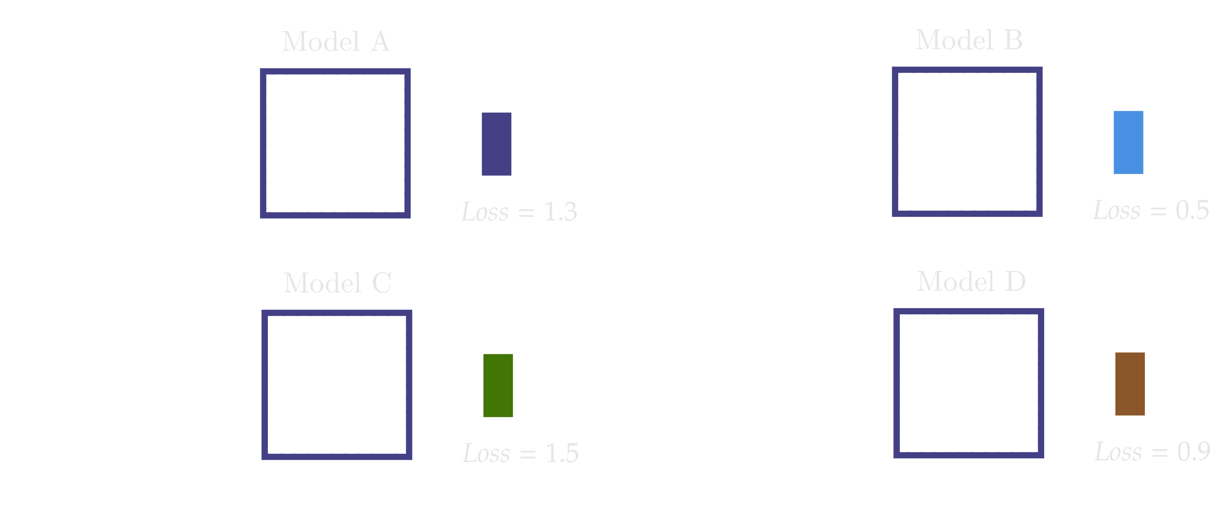
Supervised Learning Dataset
Best Model
20.

Slide 22

Supervised Learning Dataset
21.

Slide 23
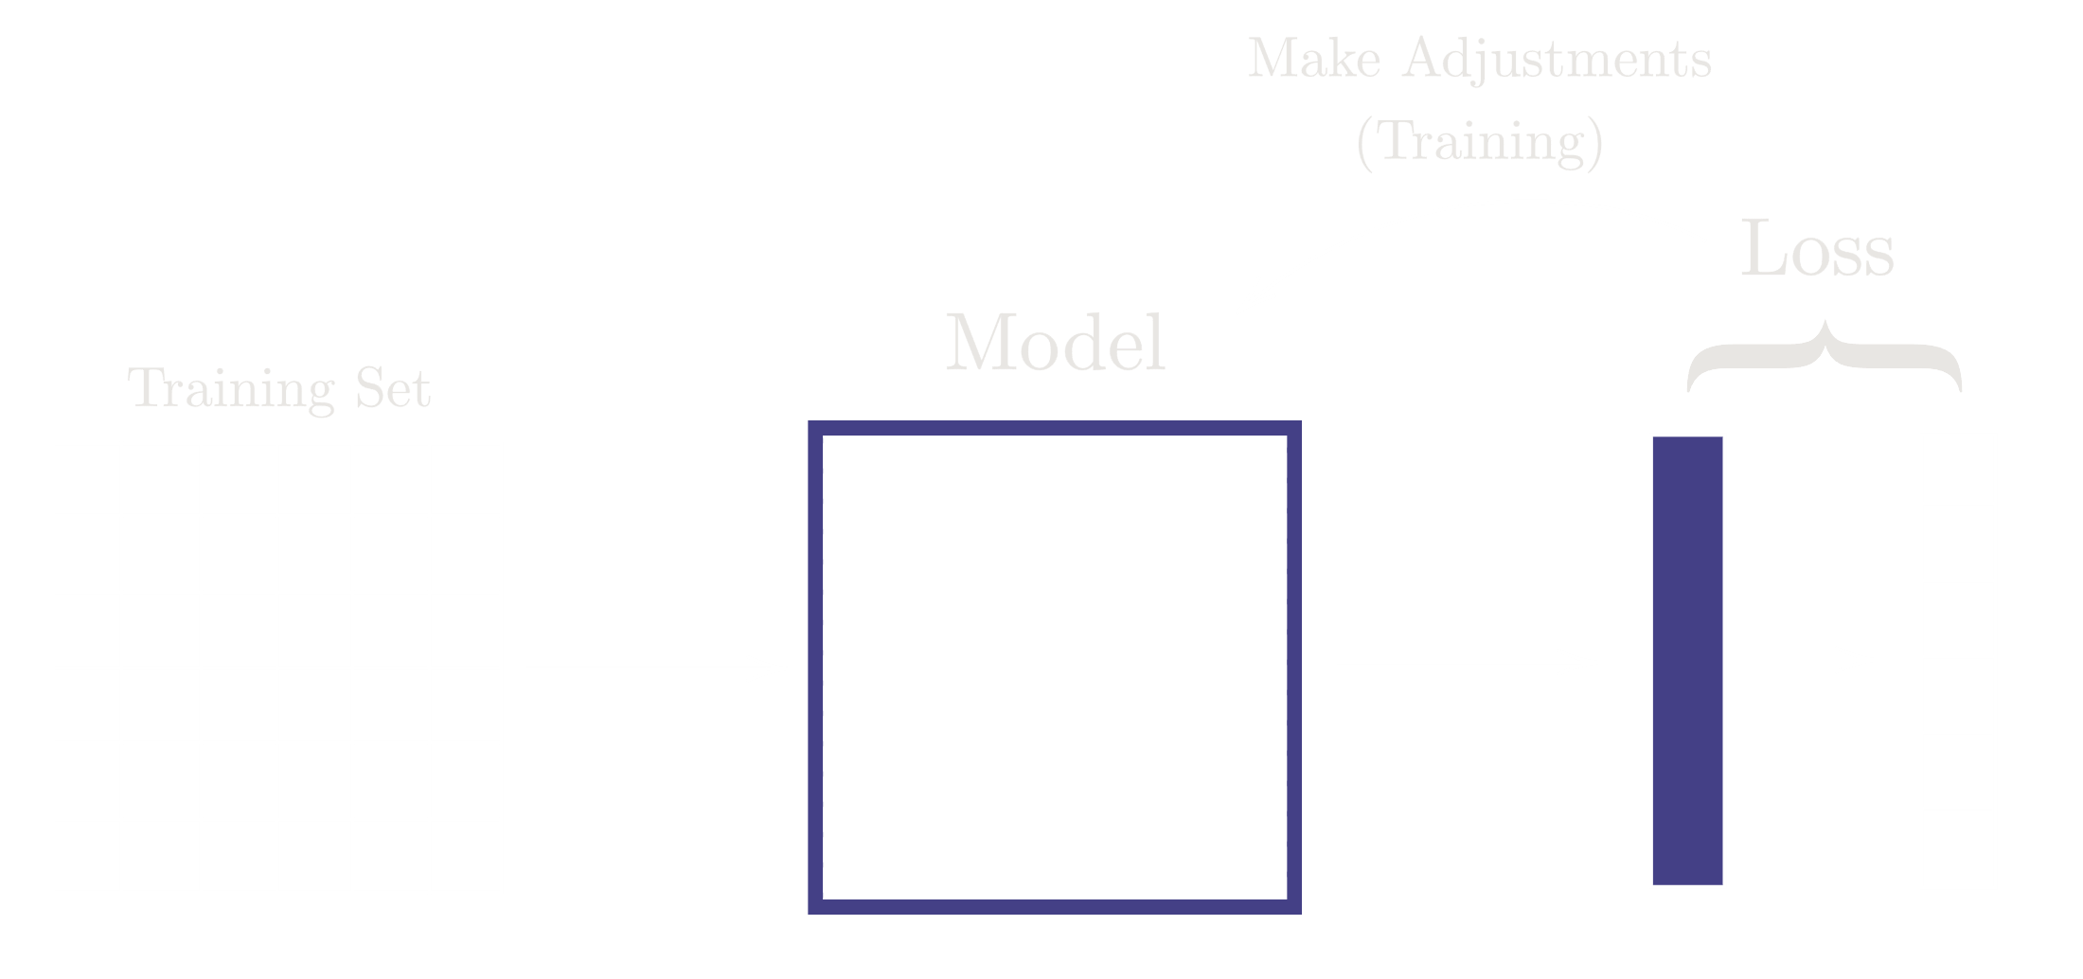
Supervised Learning Dataset
22.

Slide 24
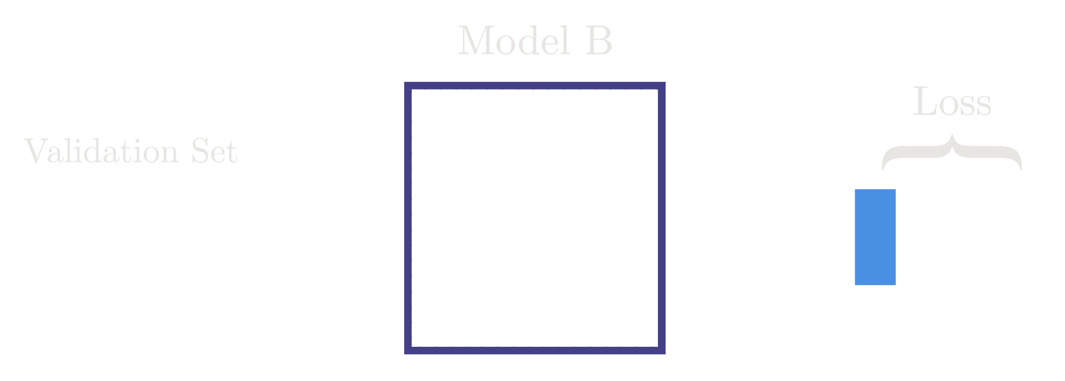
Supervised Learning Dataset
Validation set used as a reality check during/after training to ensure model can handle unseen data
23.

Slide 25

Supervised Learning Dataset
Test set used as to check how generalizable
the final chosen model is!
24.

Slide 26
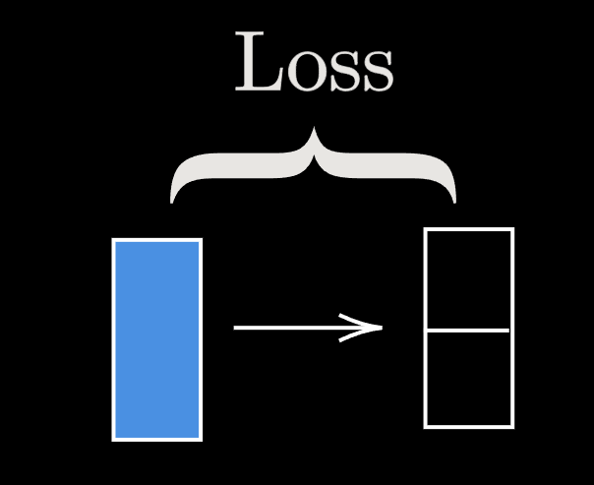
Metrics of Performance
Loss - a numerical metric that describes how wrong a model's predictions are
25.

Slide 27


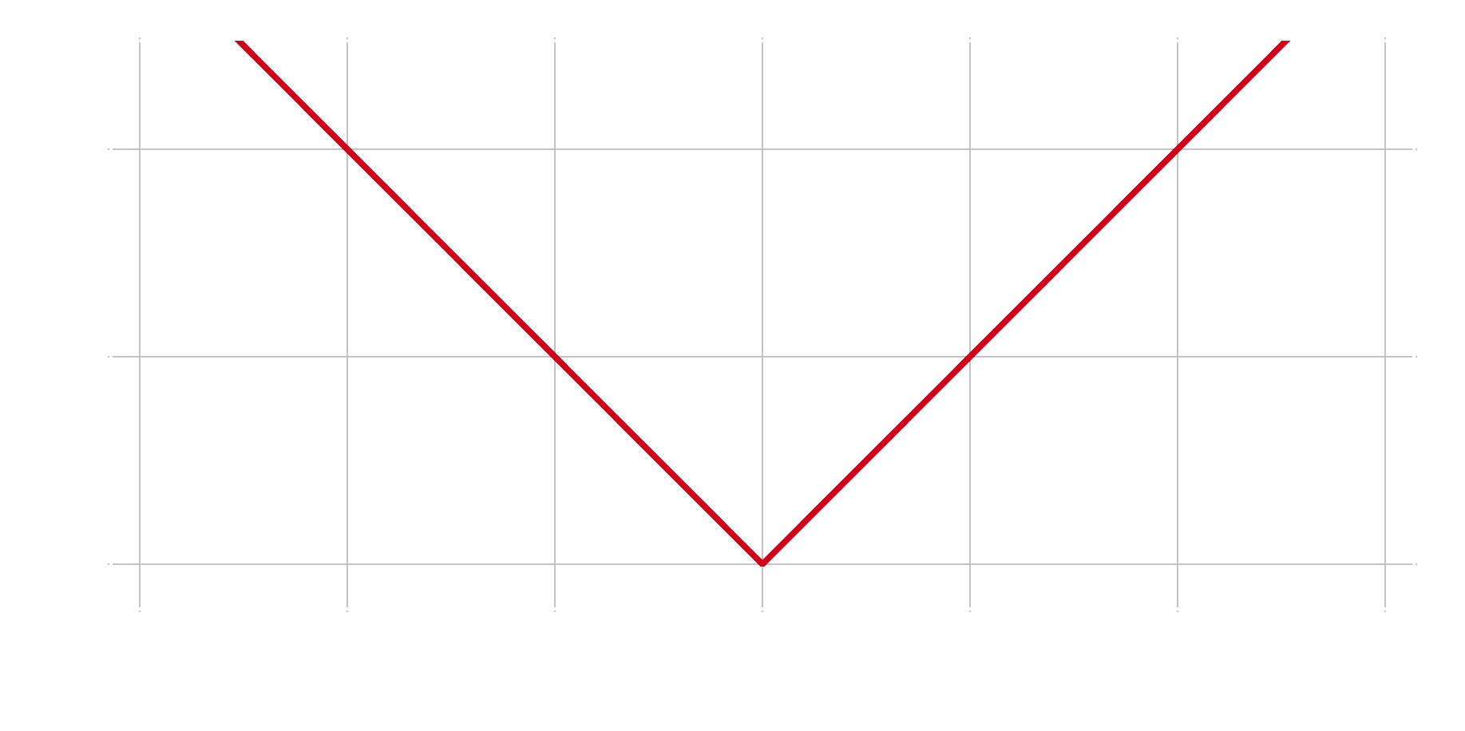
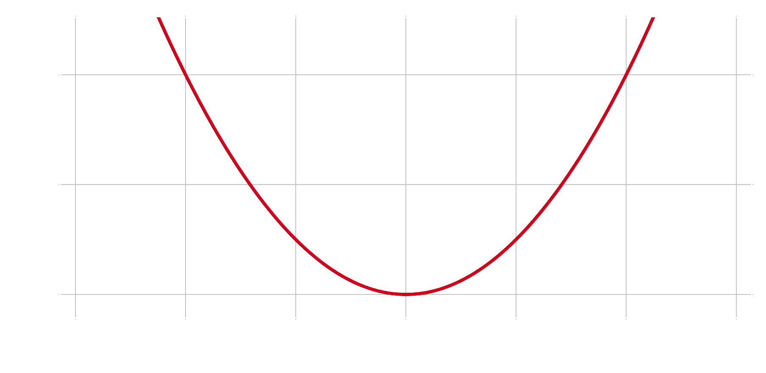
Loss Functions
L1 Regularization
L2 Regularization
26.

Slide 28

Loss Functions
Binary Cross-Entropy Regularization
You just need to know that loss decreases as the performance gets better!
27.

Slide 29

Metrics of Performance
Accuracy
Accuracy - a metric that measures how often a machine learning model correctly predicts the outcome
28.

Slide 30
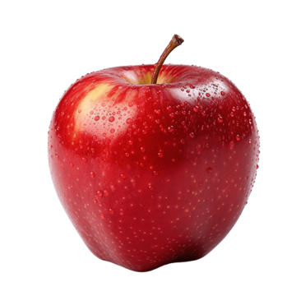
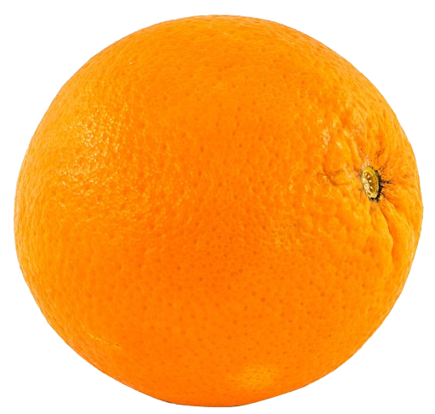
Metrics of Performance
Predictions
Actual
Apple
Apple
Orange
Orange
Accuracy of the model is ¾, or 75%
Orange
Apple
Apple
Apple
29.

Slide 31
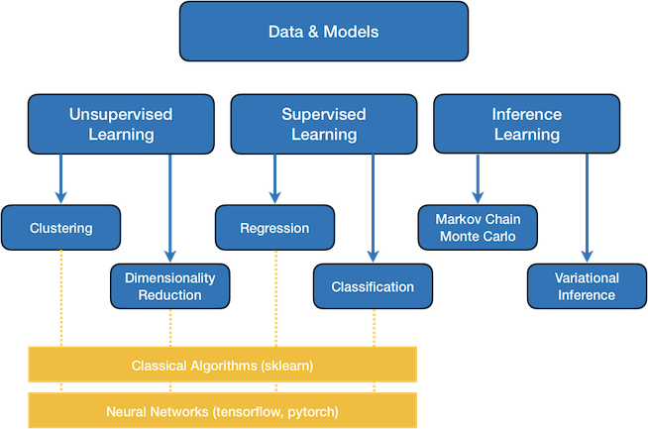
Summary
30.

